Slide 1
Big Data Technology YouTube Trending Video
PROJECT PRESENTATION
Instructor:
Prof. Mrudula Mukadam
Group Members:
Suresh Prajapati (109524)
Sovichea Cheth (985421)
Sunena Gwachha (109578)

Slide 2
Overview
Using Spark streaming to stream data
Using Hive/HBase to store data
Using Zeppelin tool to visualize data
Demo project on Kafka

Slide 3
Part I: Spark Streaming
Flume
Spark
Streaming
HBase

Slide 4
Part II: Spark SQL and HBase
Integrate Spark SQL with HBase
Import library files first
Create methods to convert bytes[] to String
Create temporary table
Run queries

Slide 5
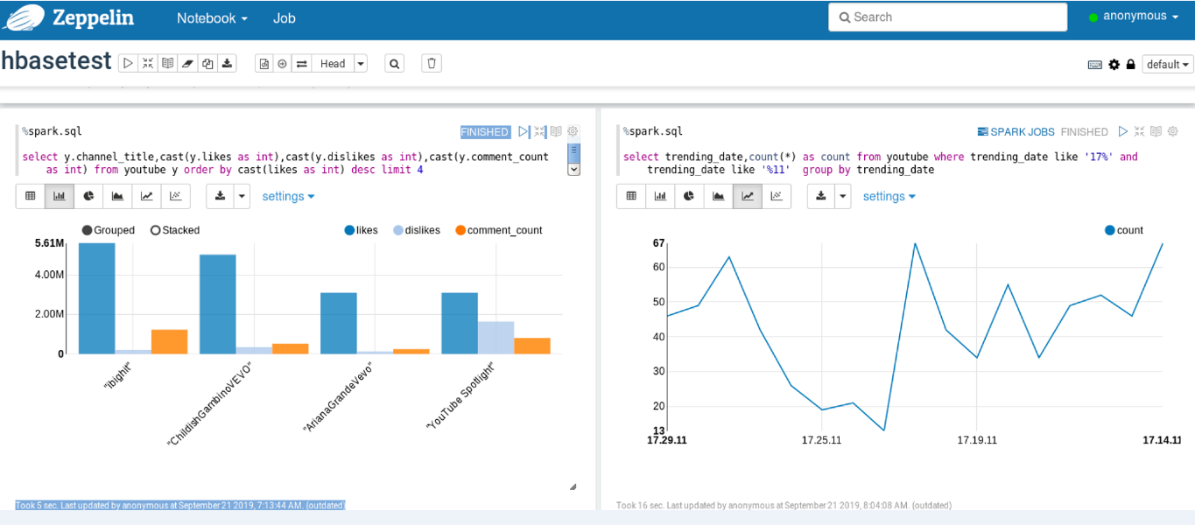
Part III: Data Visualization (Zeppelin)
Read the data from HBase using schema
Execute Query

Slide 6

Part IV: Demo Project on Kafka
Create demo project in Java
Define the Kafka producer properties configuration and topic
Read the rows from CSV file and write the messages
Stream the data into HBase

Slide 7
Components
Dataset
https://www.kaggle.com/datasnaek/youtube-new
Spark Streaming
Stream YouTube data and store in HBase
HBase
Execute Spark SQL to query HBase
Zeppelin
Display and visualize the result
Kafka Streaming
Producer pulls the data from CSV file and Consumer received the data

Slide 8




Data Flow
Text File
INSERT
QUERY
8

Slide 9
Demonstration Thank You!

